Slide 1
Logic Design Final Project
Fall 2016
Topic: Traffic Light
+
Reaction Time Game
Team #: 12
Members: 何榮晟 and 賀冠軒

Slide 2
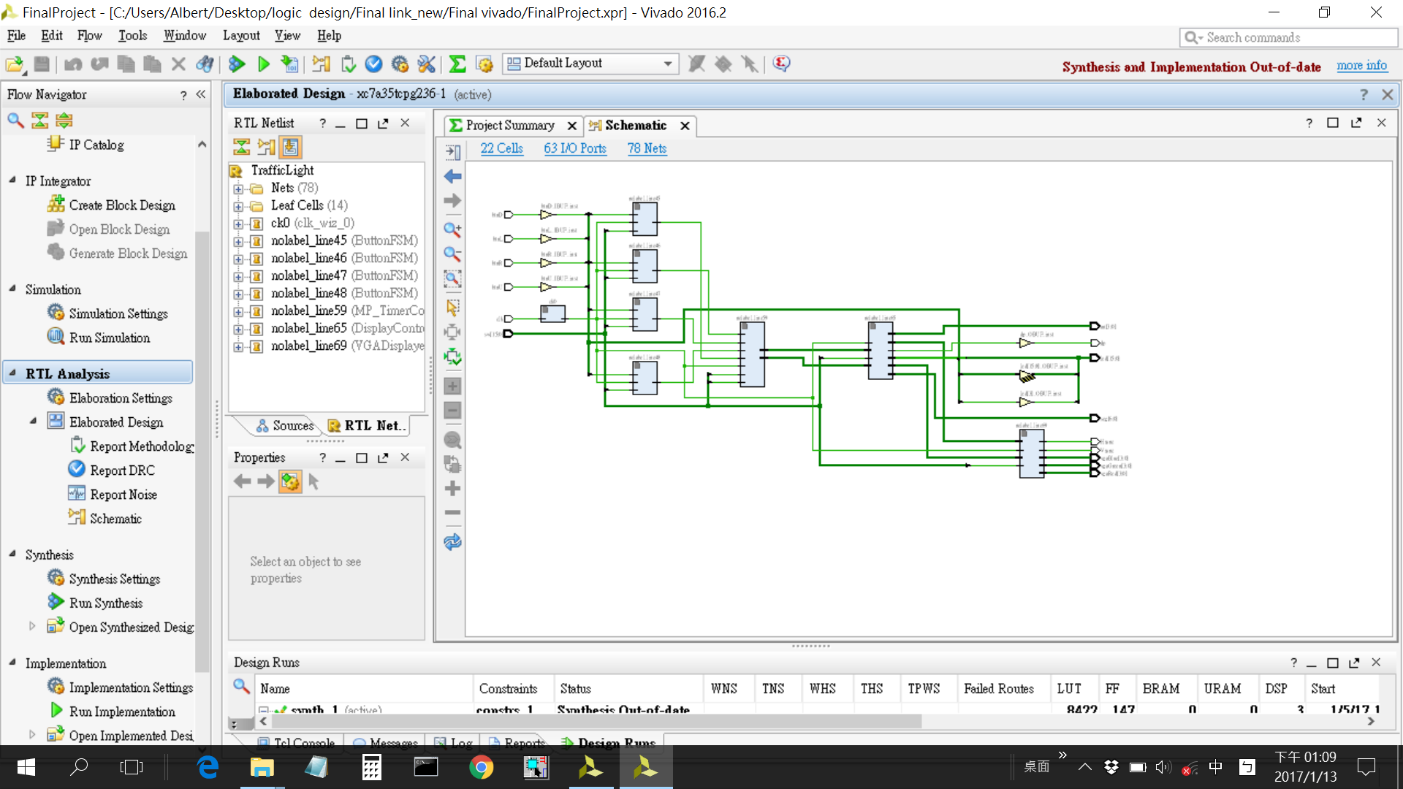
Baseline Design
Set and display traffic signal for cars and pedestrian
Architecture design
  System block diagram
  Gate count: 8658
Demo
Logic Design

Slide 3
Extension
A game to train one’s reaction time
LED: output signal (random 1 of 13 possible LEDs)
  Player has to choose the corresponding switch LED
Switch: player input
  Timer stops when the switch below the lit LED is flipped
Seven-segment display: timer for reaction time
  Displays in milliseconds
Logic Design

Slide 4
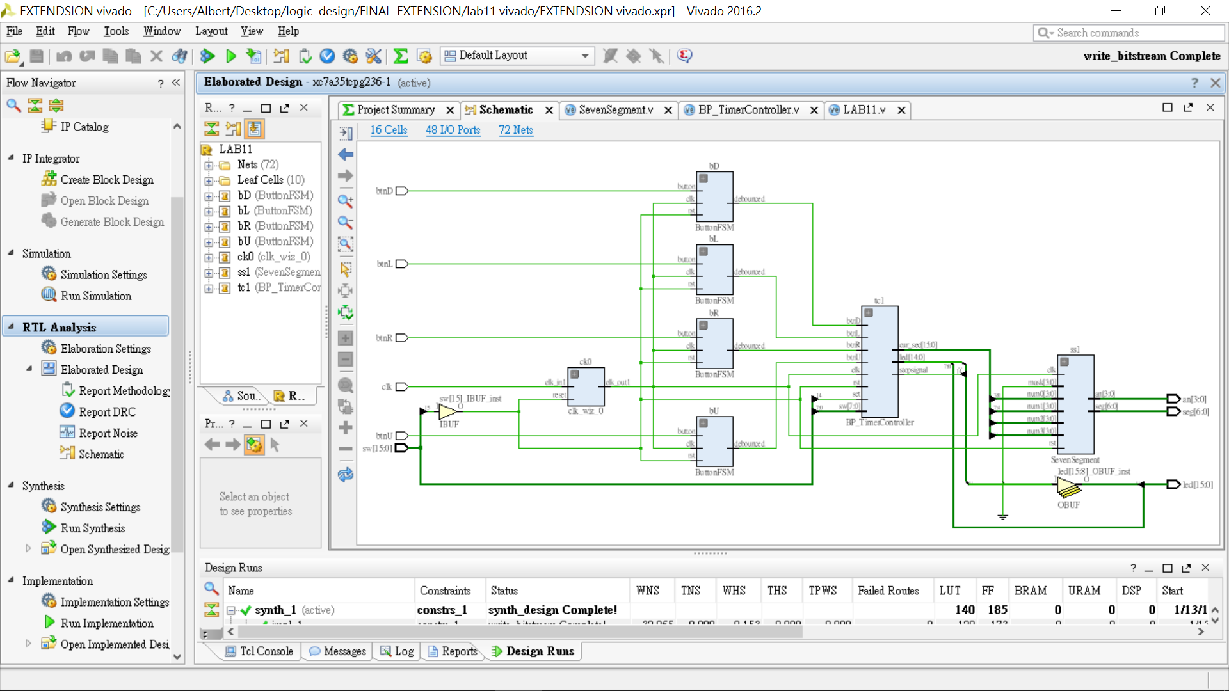
Extension
Architecture design
  System block diagram
  Implemented decimal-to-BCD encoder
  Implemented pseudo-random mechanism
  Gate count: 602
Demo
Logic Design

Slide 5
What We’ve Learned
We initially were indifferent to the class, however, after completing this project, we have now become very interested in the area of circuit design, and wish take further, more in-depth classes to learn more.
Logic Design

Slide 6
Teamworking
Baseline Submodule
  Trafficlight: 賀冠軒
  MP_TimerController: 何榮晟
  DisplayController: 何榮晟 and 賀冠軒
Extension
  All files:何榮晟 and 賀冠軒
Presentation
  Slides:何榮晟 and 賀冠軒
  Demo:何榮晟 and 賀冠軒
Overall: 何榮晟 = 50%, B=50%
Logic Design

